Slide 1
How SQL Lighthouse uses a bouncy castle to protect user passwords A practical example of the principle of least privilege
David Simner
Notes:
Hello!

Slide 2
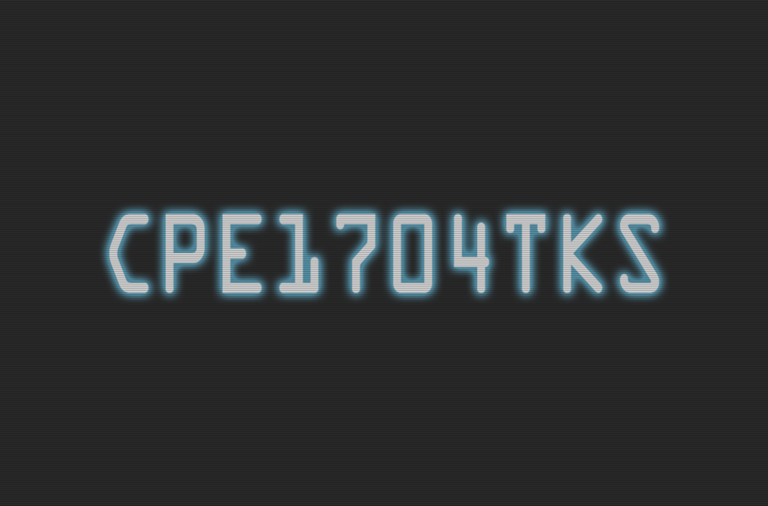

Slide 3
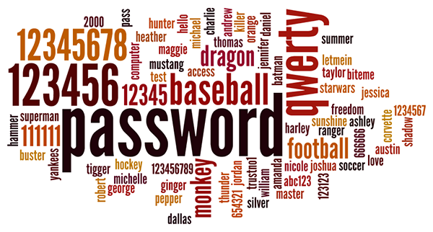

Slide 4
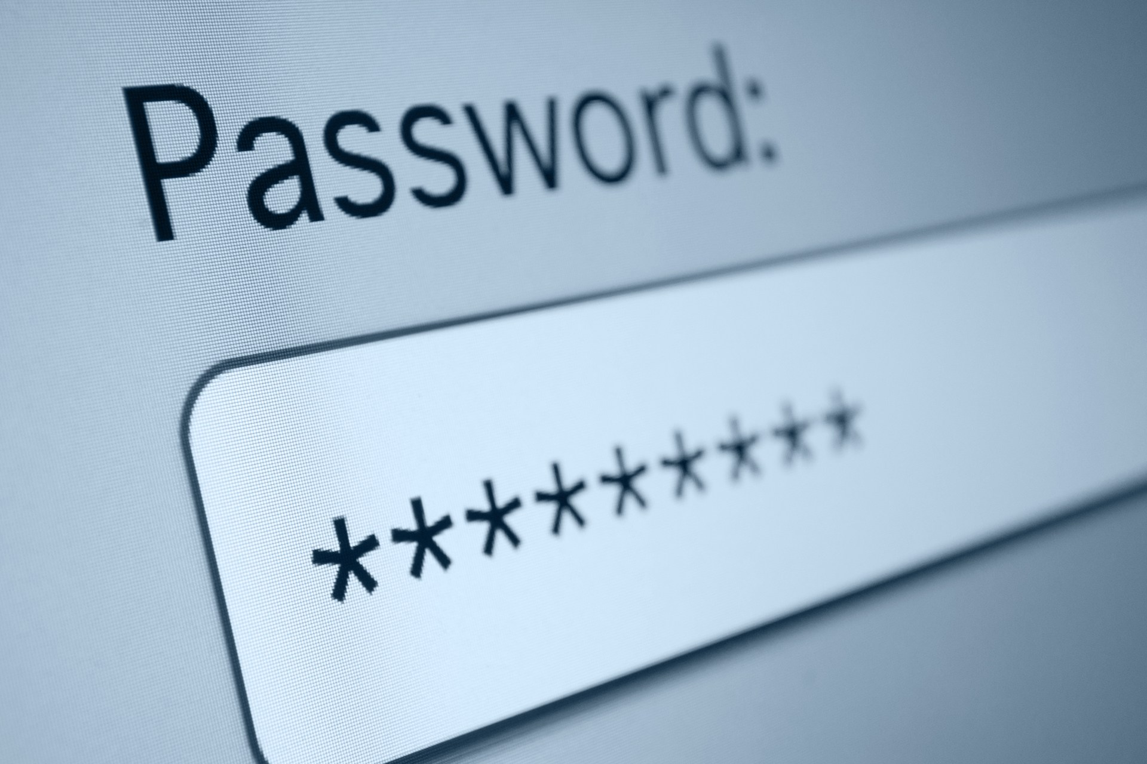

Slide 5
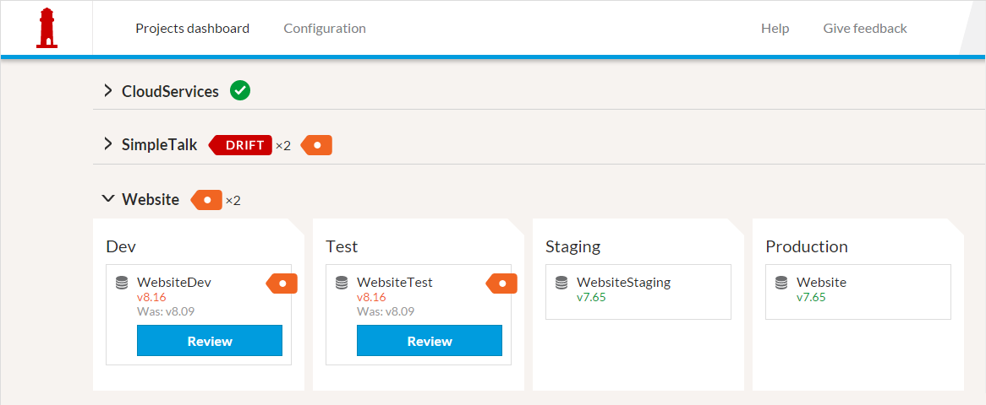

Slide 6
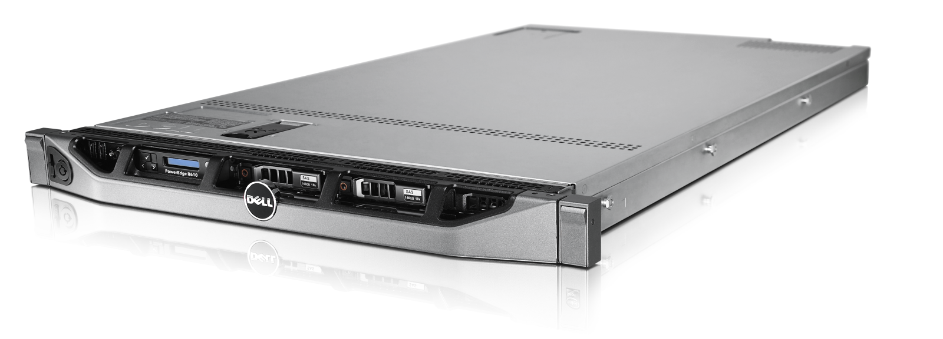

Slide 7
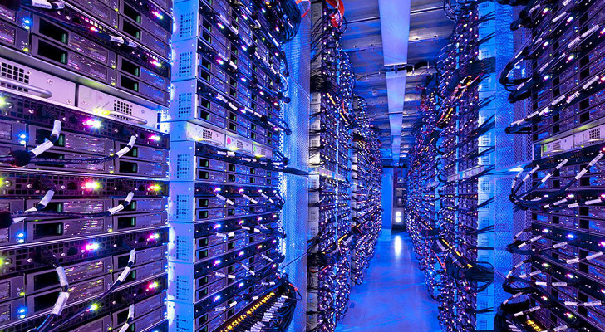

Slide 8


Slide 9


Slide 10



Slide 11


Slide 12
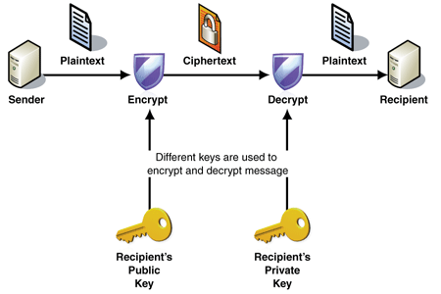

Slide 13
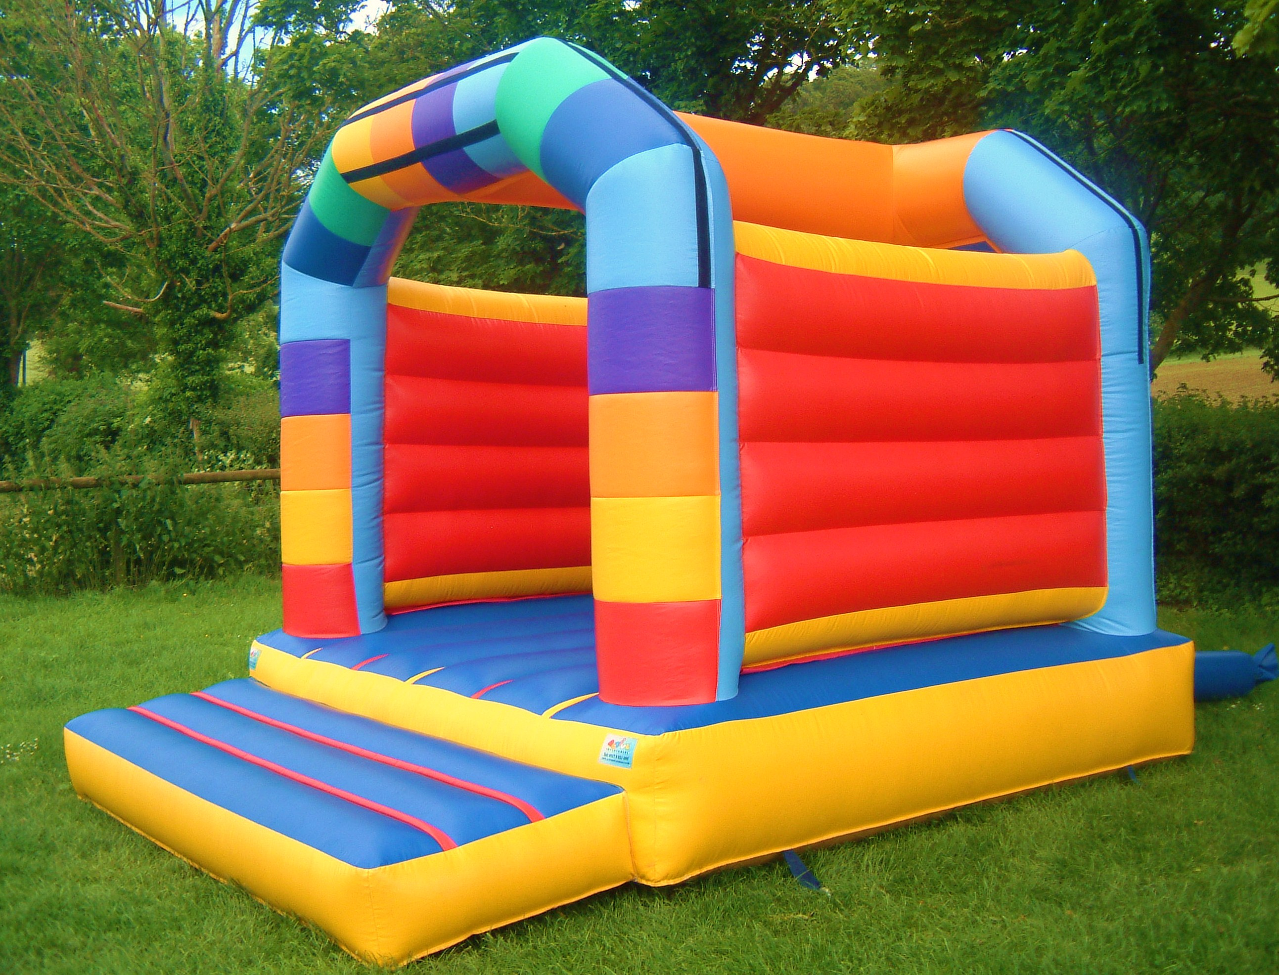
You want:
Enveloped Data
(RFC 5652)
Notes:
http://www.alvestrand.no/objectid/1.2.840.113549.1.7.3.html
https://tools.ietf.org/html/rfc5652#section-6
http://en.wikipedia.org/wiki/Cryptographic_Message_Syntax
https://www.nuget.org/packages/BouncyCastle/
http://www.bouncycastle.org/csharp/

Slide 14
Notes:
http://www.w3.org/TR/WebCryptoAPI/
http://caniuse.com/#feat=cryptography

Slide 15

“If you walked into a nuclear missile showroom you would buy Trident – it’s lovely, it's elegant, it's beautiful. It is quite simply the best. In the world of the nuclear missile it is the Saville Row suit, the Rolls-Royce Corniche, the Château Lafitte 1945. It is the nuclear missile Harrods would sell you. What more can I say?”

Slide 16
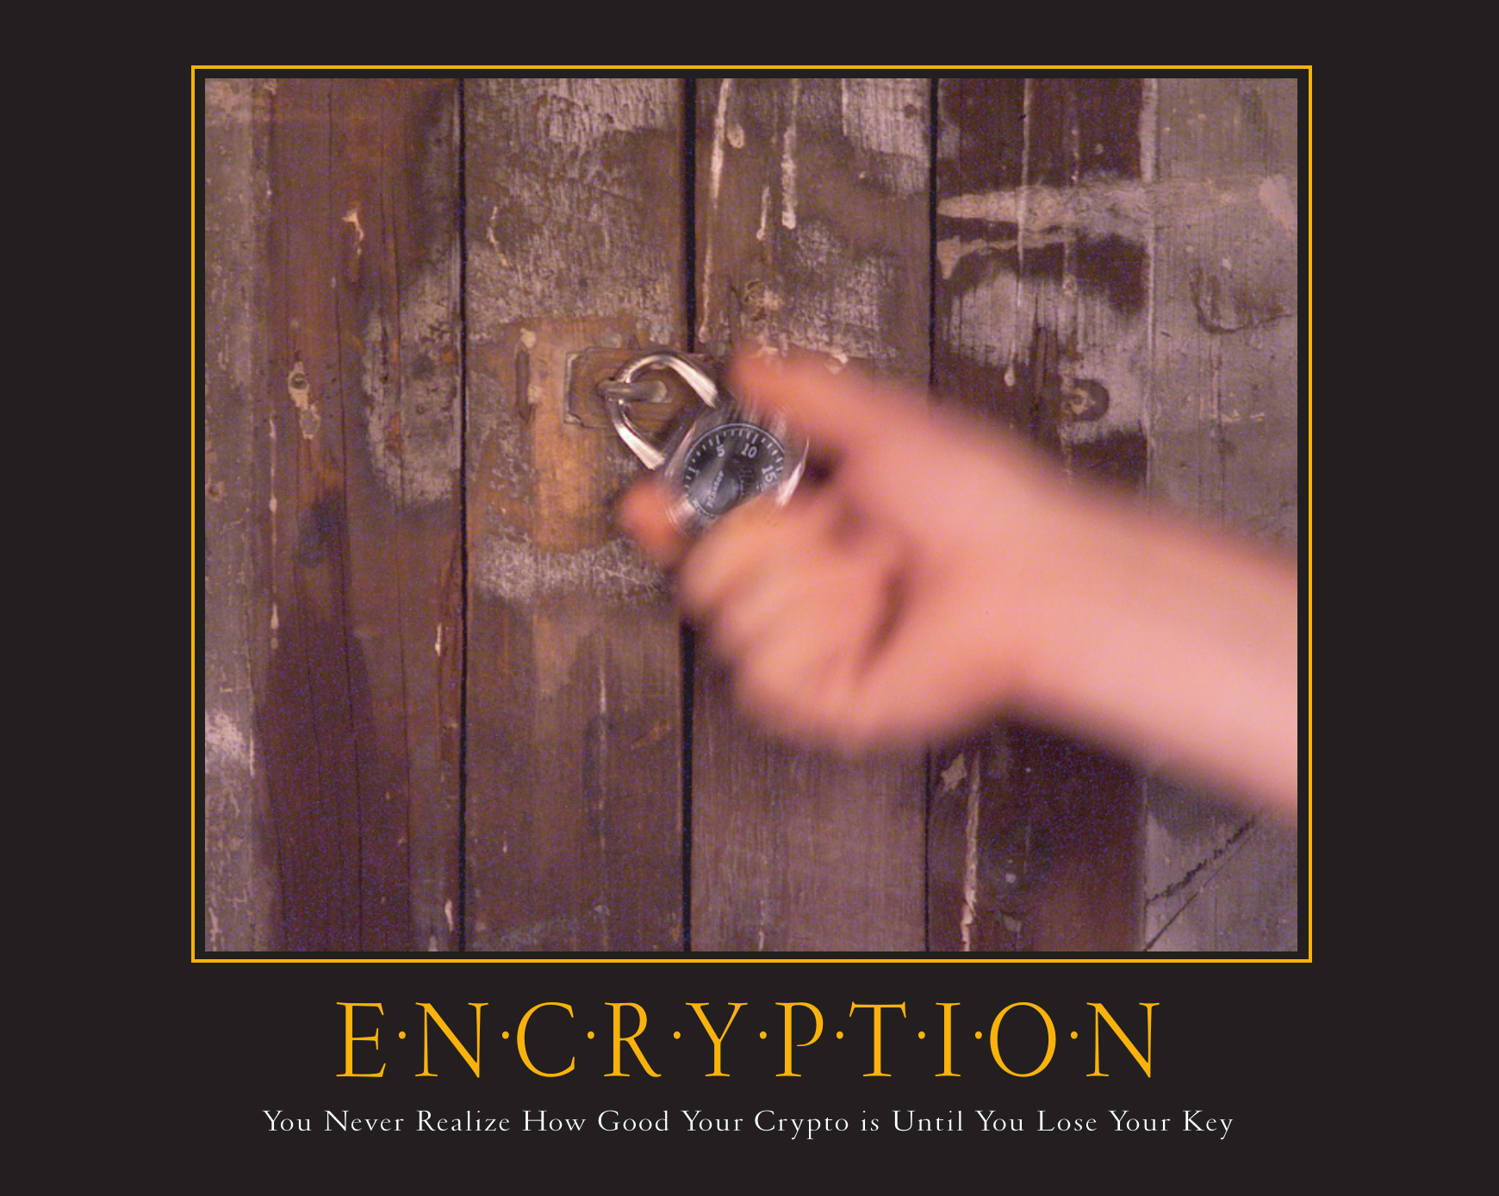

Slide 17
</talk> any questions?

